Slide 1
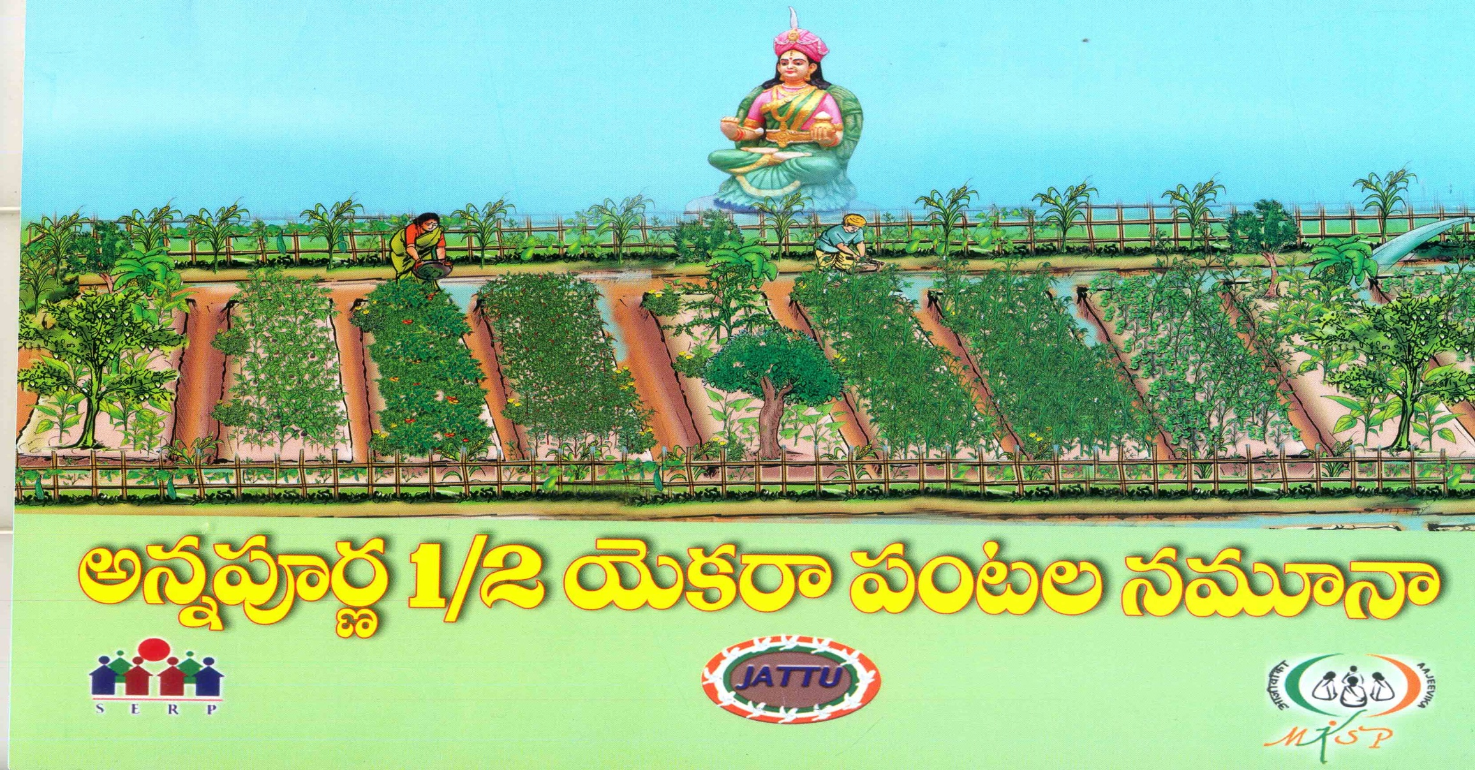
JATTU TRUST Progress report 31.03.16

Slide 2
Details of the projects in the State of Andhra Pradesh
Name of the PIA | Year of inception | Name of the districts | Name of the blocks | Number of villages | No. of Mahila Kisan |  | Area covered
 |  |  |  |  | Targeted | Covered
Jattu Trust | 2013 | Vizianagaram | G.L.Puram |  | 1500 | 1436 | 704.5 Acres
 |  |  | Kurupam |  | 1000 | 840 | 433.5 Acres
 |  |  | Garugubilli |  | 200 | 128 | 64.5 Acres
 |  |  | Komarada |  | 100 | 27 | 13. 5Acres
 |  |  | J.M. Valasa |  | 100 | -
 |  |  | Parvathipuram |  | 100 | -
 |  | Total |  | 150 | 3000 | 2431 | 1215.5 Acres

Slide 3
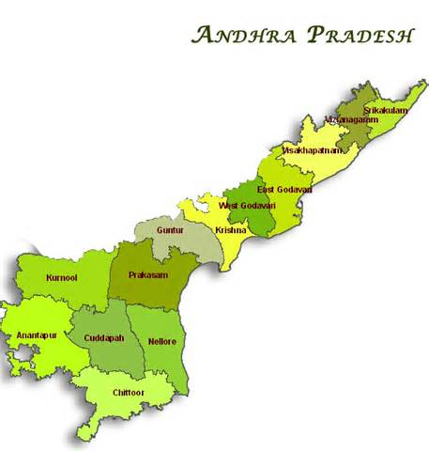
MKSP areas in the State of Andhrapradesh (please insert a map)
Vizianagaram

Slide 4
Community institution architecture for MKSP (consolidated)
 | Generic women institutions | Livelihoods based institutions | Interface/ Coordination mechanism | Activities undertaken by LH institutions
Village Level | Self Help Groups 320 SHGs covered | 150 Annapurna pantala Sangams 70 covered | CRP locally monitoring and organize weekly meetings at village level | Promotes Annapurna crop models. Build capacities on pre and post harvesting techniques and Collects village level produces
GP level
Cluster Level | Village Organization 47 Vos covered | 8 Cluster Federations | Para professional organize cluster level meetings at cluster head quarters | Promotes value addition activities, processing and marketing. Conduct trainings, Mapping resources, planning procurement
Block level | Mandala Mahila Samakhya 4 covered
District Level | Zilla Samakhya | 1 MACS | Project manager/Senior professional co-ordinate Clusters/ MACS . | Promotes value addition activities, processing and marketing. Conduct trainings, Mapping resources, planning procurement , handling greviences and documentation of best practices and co-ordinate all 8 cluster federations.
State Level

Slide 5
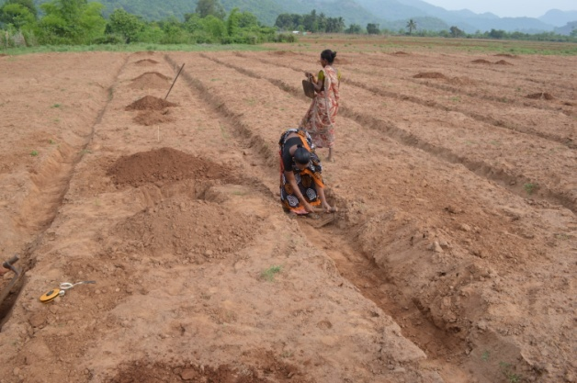
Main interventions under sustainable agriculture practices in your state
* ½ Acre Annapurna model of cultivation,
Bedding, Trenching,Furrowing and Plantation
* Practicing Non pesticide management methods and promoting their traditional methods

Slide 6
Physical progress- SA/NTFP (consolidated)
Particulars | Target as per sanction order/DPR | Cumulative achievement till last reporting quarter | Achievement in the current quarter | Plan for the next quarter
No. of Mahila Kisan covered-SA/NTFP activities | 3000 | 1463 | 968 | 250
No. of Mahila Kisan in NRLM compliant SHGs | 3000 | 1463 | 968
No. of trainee days completed on SA/NTFP for Mahila Kisan | 9000 | 4389 | 1545 | 3066
No. of Producer groups formed | 150 | 70Village level,7Cluster level | 10 | 50
No. of Mahila Kisan in the fold of PGs | 3000 | 1463 | 460 | 508
Total No. of HHs adopting SA/NTFP practices | 3000 | 1463 | 968 | 250
No. of training modules developed-SA/NTFP
Print | 4 | 3
AV | 4 | 2 |  | 1
No. of training modules used for training-SA/NTFP
Print | 4 | 3
AV | 4 | 2

Slide 7
Physical progress-CRP creation-SA/NTFP/Livestock activities (consolidated)
Particulars | Target as per sanction order/DPR | Cumulative achievement till last reporting quarter | Achievement in the current quarter | Plan for the next quarter
No. of CRPs identified | 500 | 120 | 30 | 100
No. of CRPs trained and deployed | 30 | 30
No. of training modules developed for CRP training
Print | 4 | 3
AV | 4 | 2
No. of trainee days of training for CRPs | 180 | 180

Slide 8
MKSP Progress (consolidated)
 | Target as per sanction order/DPR | Cumulative achievement till last reporting quarter | Achievement in the current quarter | Plan for the next quarter
Net cropped area (Acres/ Models) under SA for Kharif season crops | 2431 models/1212.5Acres | 731.5 |  | 250
Net cropped area (Acres) under SA practices for Rabi crops | 2701 models/1350.5 acres

Slide 9
Physical progress-Livestock activities
Total No. of Mahila Kisan covered till date: 2431
Total no. of HHs covered till date: 2431
Total No. of Producer Groups formed: 70
Total No. of Para professionals trained and deployed at village level: 8
All cumulative figures required here

Slide 10
Output measurement… (give consolidated figures)
Parameters | Status as per baseline | Current status | % increase over baseline
Total volume of Major crop-output/NTFP (Major product) produced (quintals) | Practicing only mono cropping in 40% of fields remaining were barren lands. | Practicing mixed crops | 100%
Gross output of agri-intervention (Major Crop) only/NTFP activity (in Rs. Lakhs) | Rs.4862000/- | Rs.23095222/- | 400%
No. of crops /NTFP produce marketed through collective marketing |  | 2 | Vegitables, lemon grass marketed through collective marketing. Remarks : ½ Acre Annapurna crop model objective is improve food security among families
No. of Mahila Kisan benefited through collective marketing |  | 160

Slide 11
Training Module Development
Name of the Theme on which module developed | Type of training module | Number/units developed so far
TOT for CRP (grooming) | Annapurna model of agriculture practices | 1
Agriculture | Traditional agricultural practices in Parvathipuram Tribal area | 1
Gender
Community Institution building | Organization of pantala sanghams. Rolls and responsibilities of office bearers / CRPs / C.Cs / Project Manager | Included in Annapurna model of Agriculture practices booklet
Training of project management/ execution team | -do- | -do-
Natural Resource Management | Preparation of Natural decortions | -do-
.

Slide 12
Name of training module | No. of beneficiaries trained | mode of training/CB | Total training days | Resource agencies/ Persons who have imparted training
Understanding on Traditional Agriculture and modern agriculture | 1978 | Class room training, field visit, and learning by doing | 5934 | Jattu Trust, C.C, T.C and P.M
Natural Agricultural scientists and other Govt Institutions. Working on organic Agriculture | “ | “ | “ | Jattu Trust, C.C, T.C and P.M
Non negotiables in organic agriculture practices. | “ | “ | “ | Jattu Trust, C.C, T.C and P.M
Annapurna model of agriculture practices | “ | “ | “ | Jattu Trust, C.C, T.C and P.M
Total no. of Modules: 4 | Total 1978 |  | Total no. of days 5934

Slide 13
Name of training module | No. of CRPs/PRPs trained | mode of training/CB | Total training days | Resource agencies/ Persons who have imparted training
Understanding on traditional Agriculture and modern agriculture | 30 | Class room training, field visit, and learning by doing | 180 | Jattu Trust Executive Trustee, PM MKSP and T.C
Natural Agricultural scientists and other Govt. institutions working on organic Agriculture | “ | “ | “ | “
Non negotiables in organic Agriculture practices | “ | “ | “ | “
Beneficiaries and Harmful insects | “ | “ | “ | “
Annapurna model of agriculture practices | “ | “ | “ | “
Total no. of Modules: 5 | Total: 30 |  | Total no. of days :180

Slide 14
Name of training module | No. of Project staffs trained (CCs, TCs , Project Manager) | mode of training/CB | Total training days | Resource agencies/ Persons who have imparted training
Traditional and Modern Agriculture | 8 | Class room training, field visit, and learning by doing | 48 | Jattu Trust
Natural Agriculture Scientists and other Departments, Institutions working on organic farming | “ | “ | “ | “
Non negotiables in organic Agriculture | “ | “ | “ | “
Beneficiary and Harmful insects in organic agriculture | “ | “ | “ | “
Annapurna model of Agriculture practices | “ | “ | “ | “
Institution building | “ | “ | “ | “
Annapurna pantala sangham at village level, cluster level and project level | “ | “ | “ | “
Total no. of Modules | Total 8 |  | Total no. of days 48

Slide 15
Physical asset creation
Individual level
Source of Funds | Name of the Asset/ Infrastructure created/ given | Number | Total Value of assets
MKSP and 20% community labour contribution | Trench around the Bunds 1.5 x1 width x depth ,Furrows with seven feet gap ,Fruit plants, Fencing around the bunds | 2431 | 17017000
MKSP | Water tubs | 608 | 126909
Community Level
Source of Funds | Name of the Asset/ Infrastructure created/ given | Number | Total Value of assets
Convergence with agriculture Dept | Oil engines, water carrying pipes and power weedors. | 5 oil engines, 175 pipes, 1Weedor, 1 Grass cutter | 170240
Convergence with Nabard | Solar pump set | 1 | 184348
Total |  |  | 481497

Slide 16
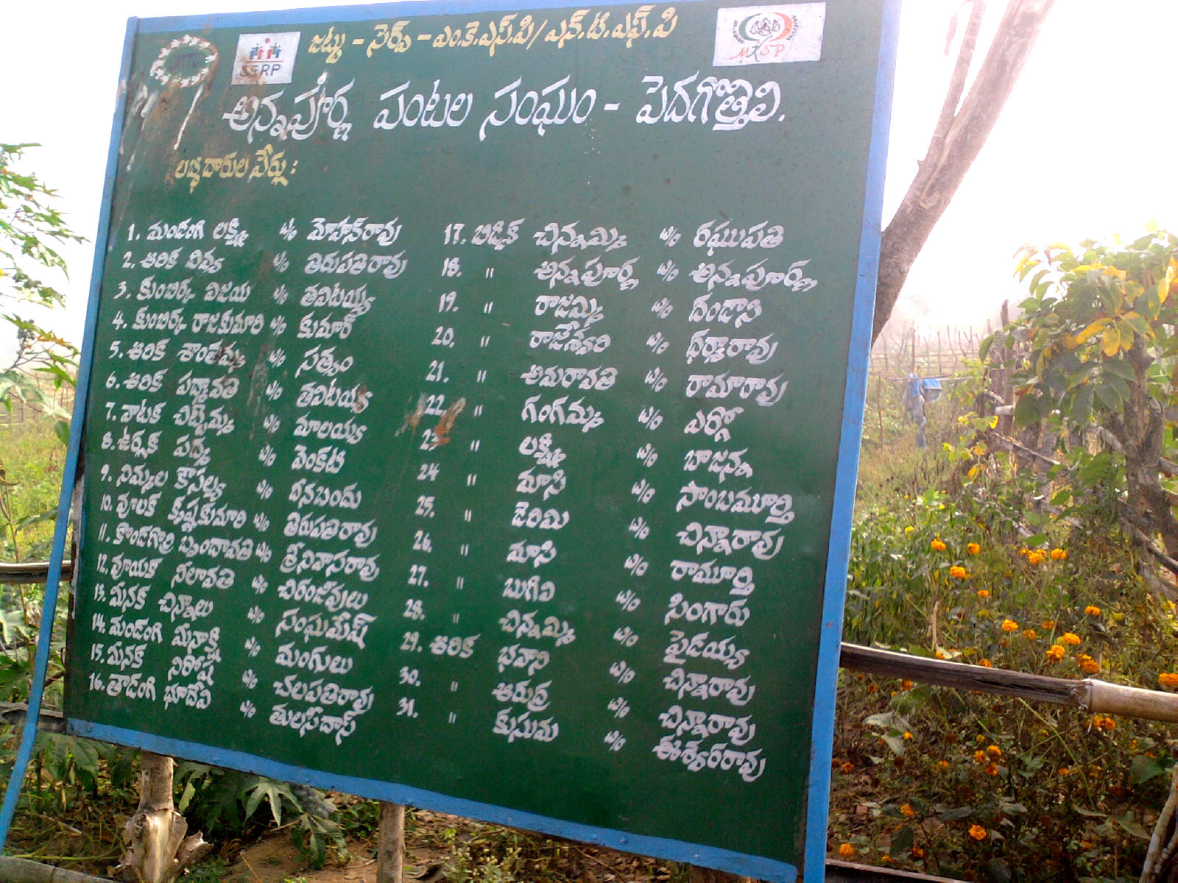
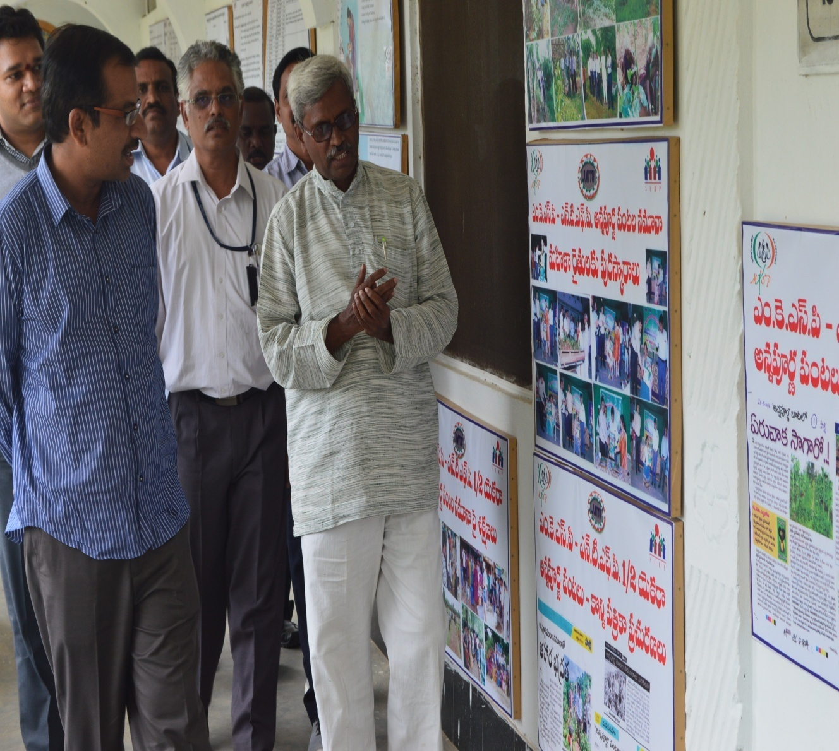
Public disclosures

Slide 17
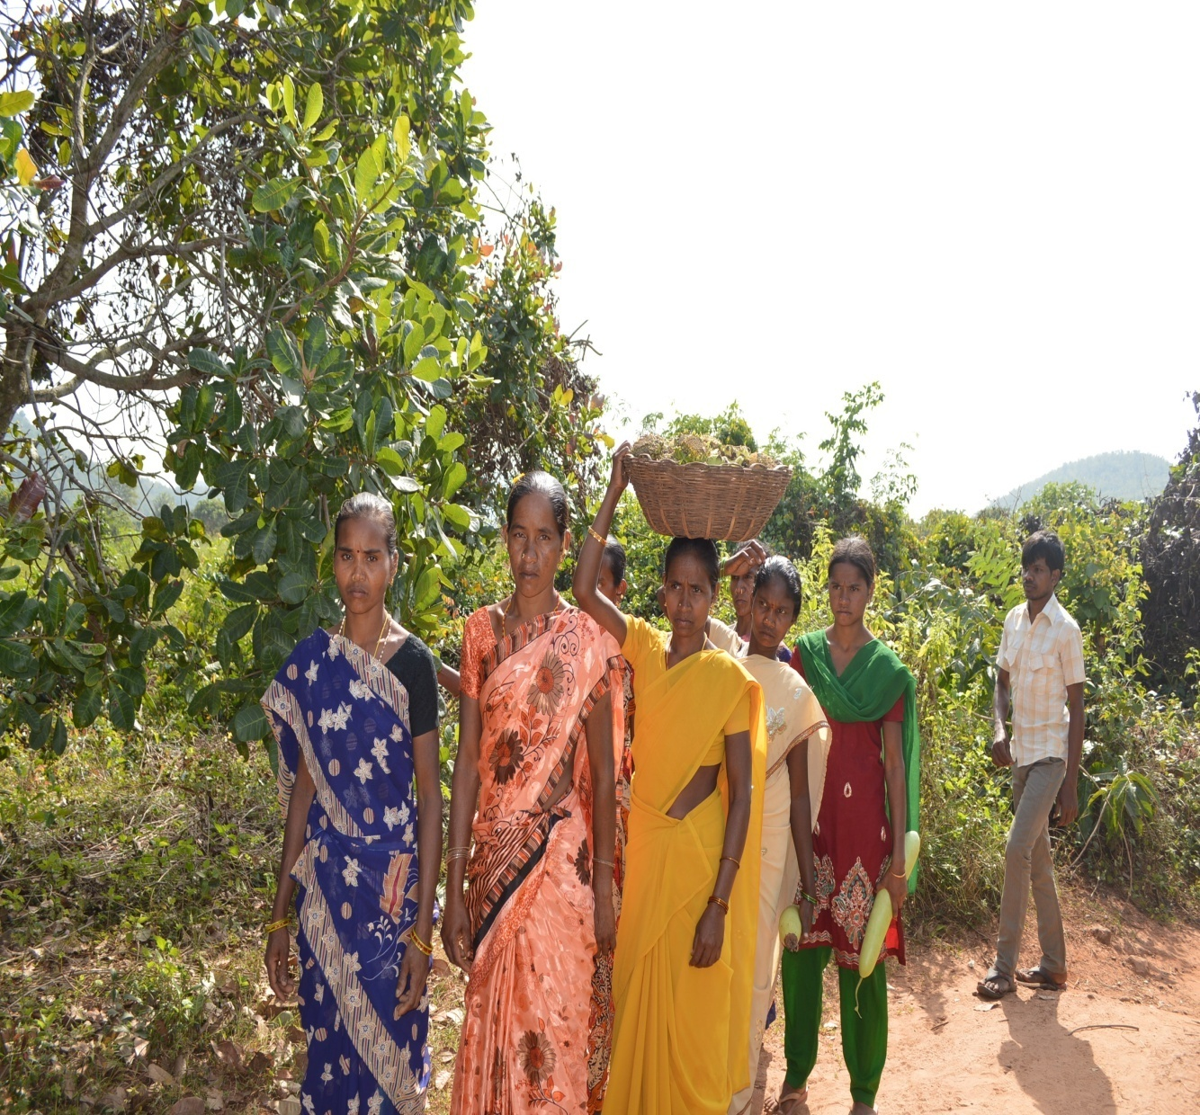

Slide 18
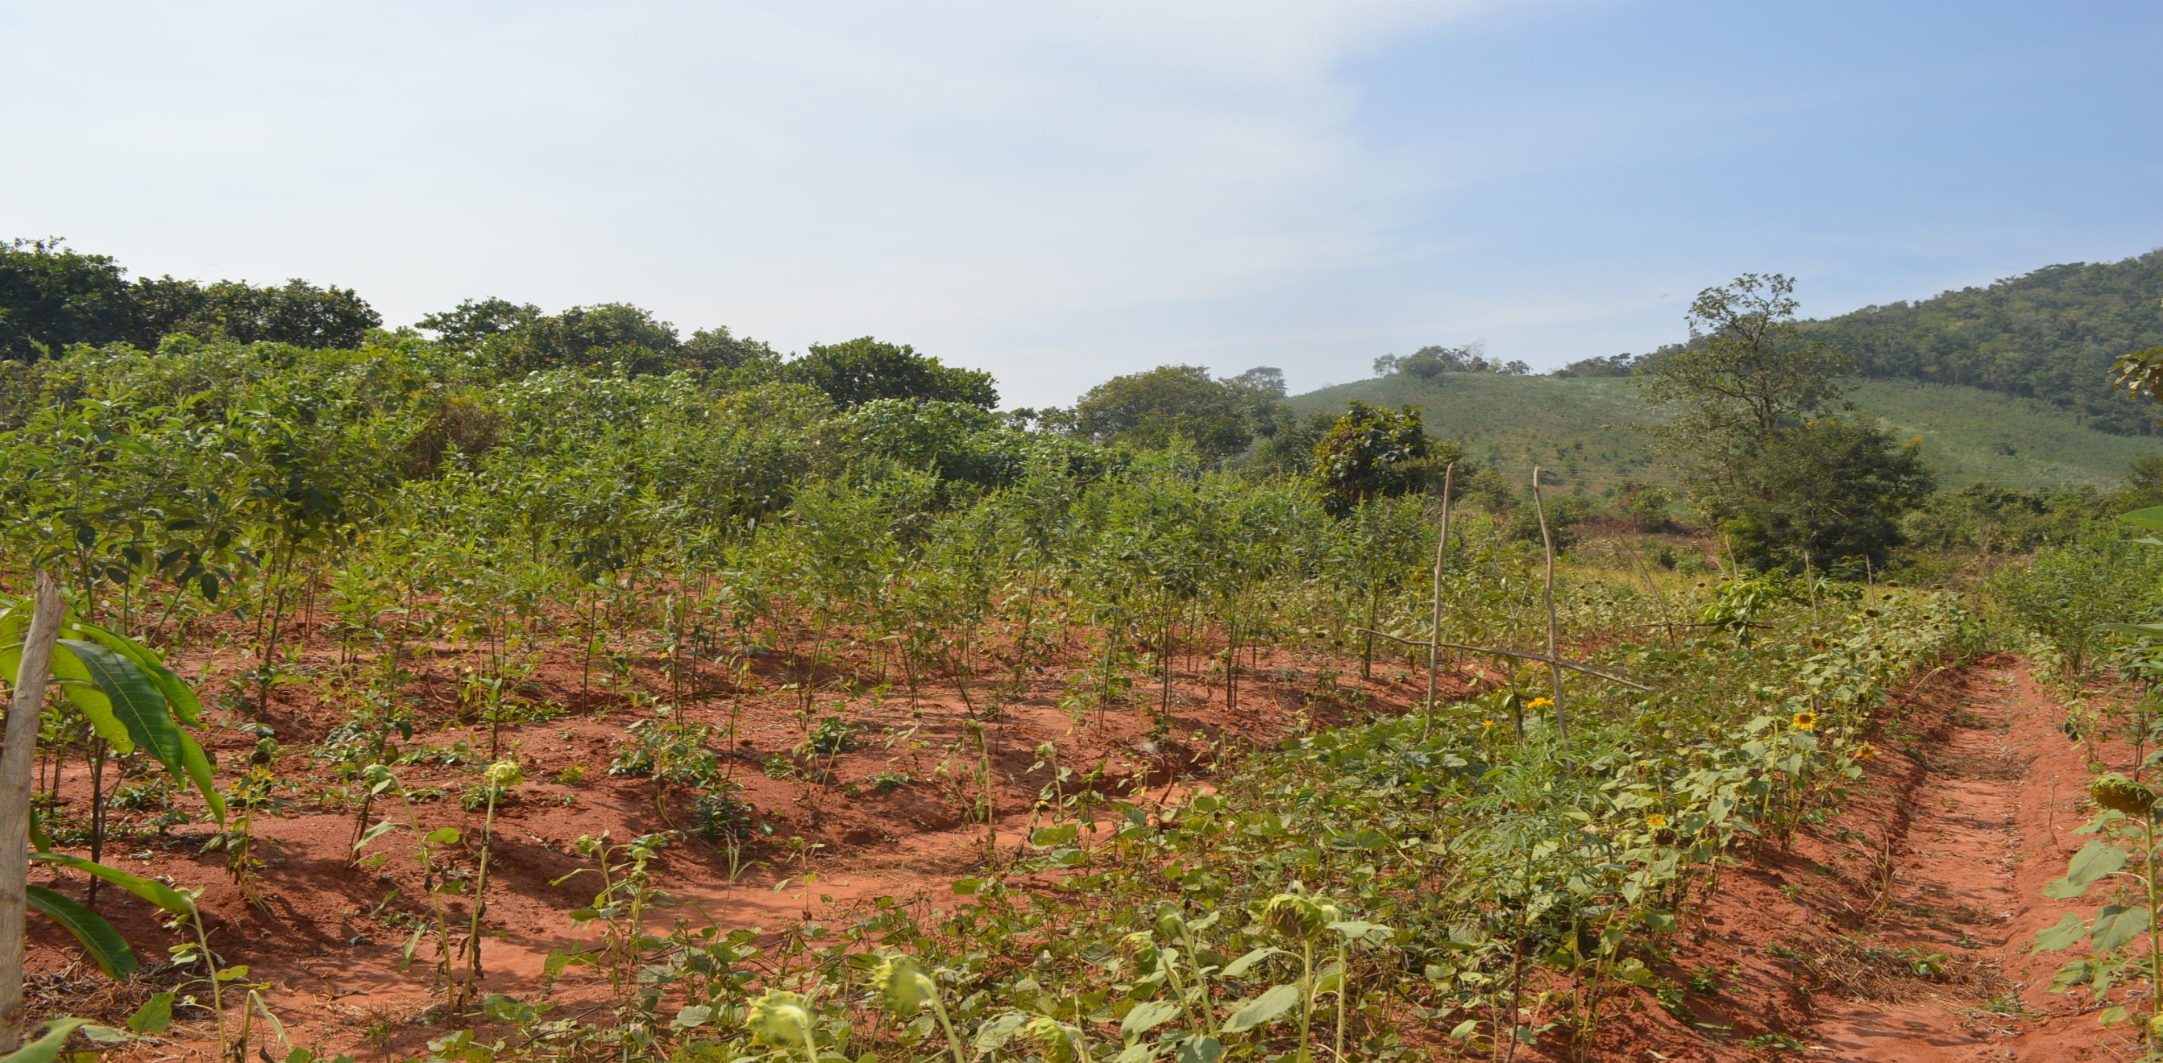
Thanks…

